Slide 1
Taming the Microsoft Graph for the IT

Slide 2


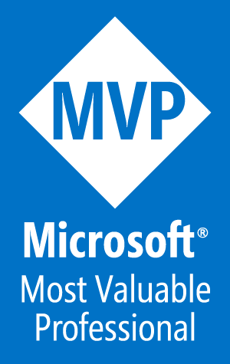
Todd Klindt
15 Year SharePoint MVP
Blogger, Speaker, Consultant at Sympraxis Consulting
todd.klindt@sympraxisconsulting.com
@toddklindt
https://www.toddklindt.com/techorama
Notes:
sing and dance PowerShell

Slide 3
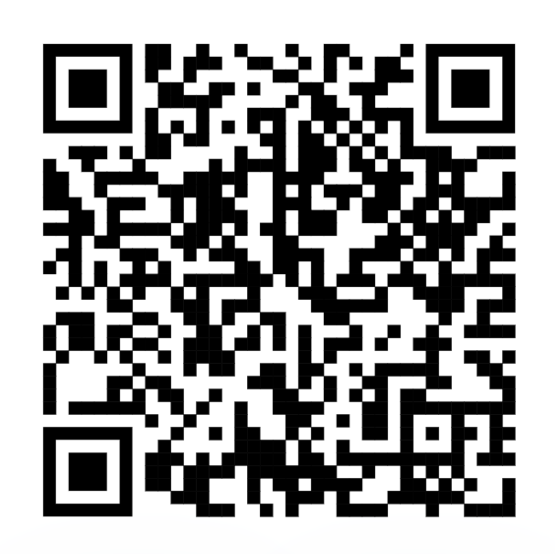
Agenda
What is the Graph?
Ways to interact with the Graph
Lots of demos

Slide 4
What is the Graph?

Slide 5

History of Graph
FAST acquisition - 2008
Oslo and Office Graph – 2014
Yammer Enterprise Graph
Delve
Office apps
Microsoft Graph – 2015
Adds in Azure AD
Windows, etc
Notes:
Delve introduced the concept of ML

Slide 6
Why the Graph?
Each application and service had its own API
The Graph is a unified API
What’s in it for IT Pros?
One, somewhat standard, interface
A promise that it will work, sort of
What’s in it for Microsoft?
One interface
We won’t go poking around, causing trouble

Slide 7

Graph? Substrate? Oh, my!
Substrate
Underlying layer of data
Graph
A unified API to access the Substrate
tomayto, tomahto
This Photo by Unknown Author is licensed under CC BY-SA

Slide 8
What’s in the Graph?
Users and Groups
AzureAD
Application Data
SharePoint / OneDrive
Exchange / Outlook
Teams
Planner
OneNote
To Do
Application Settings
All the data services
InTune
Windows 365
Notes:
Major services and features in Microsoft Graph - Microsoft Graph | Microsoft Learn
Some stuff is copied, some stuff is referenced
Always changing

Slide 9
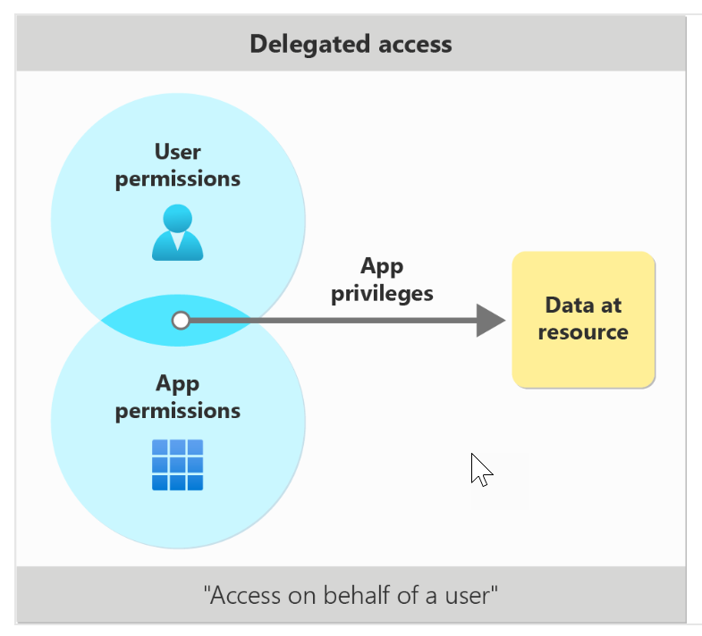
The Graph Permissions, complex? No way!
Delegated Access
aka User Access / Scopes
Logged in user
The app can’t do anything the delegated user can’t do
Sites.Read.All
Can only get to sites user has access to
Notes:
Microsoft Graph permissions reference - Microsoft Graph | Microsoft Learn

Slide 10
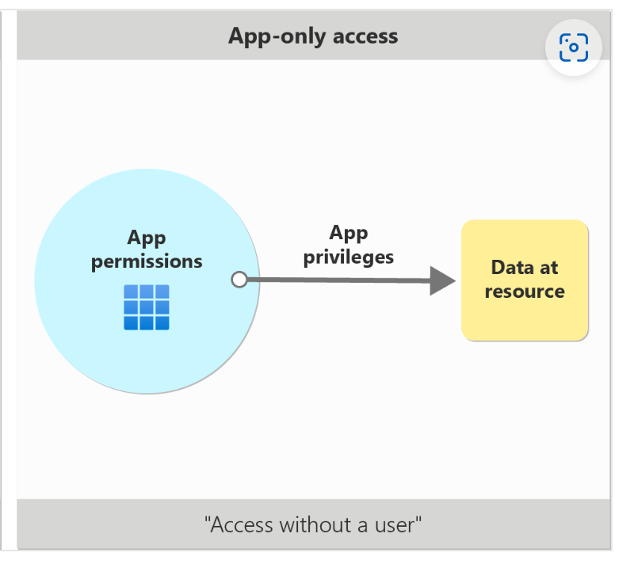
The Graph Permissions, complex? No way!
App-only Access
Application permissions / App roles
No logged in user context
Can only be consented by an Admin

Slide 11
Scope Naming Format
{resource}.{operation}.{constraint}
Sites.Read.All
Directory.Read.All
User.Read.All
User.ReadBasic.All
/v1.0
/beta
Resource-specific consent (RSC)

Slide 12
Demo!
Apps and permissions
Notes:
Azure AD
Show Enterprise apps
Show

Slide 13
Interacting with the Graph

Slide 14
Graph Explorer
https://developer.microsoft.com/en-us/graph/graph-explorer
Great place to learn
Get a Dev Tenant
No, really
Sample queries
Resources
History
Code Snippets
Permissions

Slide 15
Demo!
Graph Explorer

Slide 16

PowerShell – Graph SDK
Install-Module -Name Microsoft.Graph -Scope AllUsers
Got its fingers in everything
Find project on Github
https://github.com/microsoftgraph/msgraph-sdk-powershell
Not for the faint of heart
Cmdlets mostly generated by AutoREST
Future of AzureAD module
2.0 preview is out
Notes:
Can be used for interactive user based stuff or automated app based things.

Slide 17
Demo!
Graph SDK

Slide 18
PowerShell – PnP.PowerShell
Has Graph permissions / scopes
Has Graph cmdlets
Win – Win!
Invoke-PnPGraphMethod
Invoke-PnPGraphMethod https://graph.microsoft.com/v1.0/sites?search=*
Get-PnPGraphAccessToken

Slide 19
Demo!
PnP PowerShell

Slide 20
Using AI

Slide 21

What can AI do?
Help you do things you can already do faster
Help you do things you can already do better
What can’t it do?
Help you do things you can’t do

Slide 22
Demo!
Do AI stuff

Slide 23
Questions?
todd.klindt@sympraxisconsulting.com
@toddklindt
www.toddklindt.com
https://www.toddklindt.com/techorama

Slide 24



Feel free to use these in your presentation!

Slide 25




Slide 26



Slide 27







